Slide 1
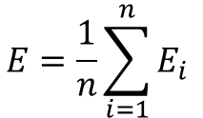
data
seed
shuffle
split
piece, k
piece 1
d11 |  |  |  |  |  | d1k
E1
piece 2
d21 |  |  |  |  |  | d2k
E2
$$E=\frac{1}{n}\sum_{i=1}^{n}{E_{i} }$$
piece 3
d31 |  |  |  |  |  | d3k
E3
. . .
piece n
dn1 |  |  |  |  |  | dnk
En
training field
test field

